Slide 1
Kit Gibbs
2nd year Computer Science
2013-2014 Academic Year
Recursion
What exactly is recursion?
When to use Recursion?
Recursion vs. Iteration

Slide 2
What exactly is recursion?
"An object is said to be recursive if it partially consists of or is defined in terms of itself"
"the power of recursion...lies in the possibility of defining an infinite set of objects by a finite statement"
- Niklaus Wirth

Slide 3
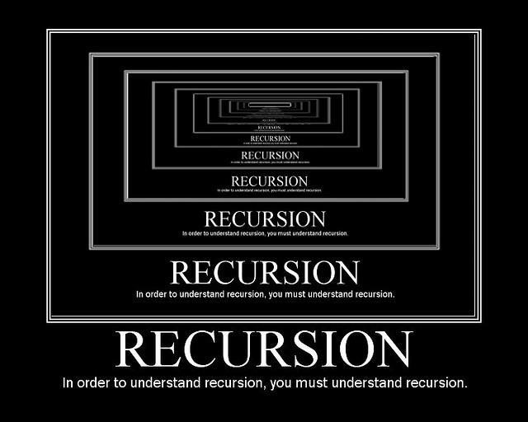

Slide 4

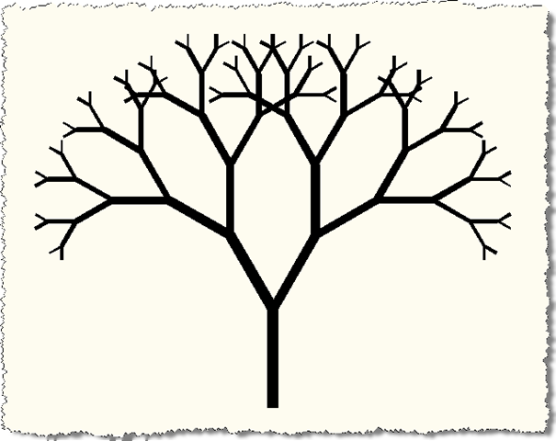
Fractals using recursion
Sierpinski Triangle
Basic tree structure
A fractal is a mathematical set that typically displays self-similar patterns, which means that it is "the same from near as from far".
Gouyet, Jean-François (1996). Physics and fractal structures.

Slide 5
When to use recursion?
Potential infinite iterations - e.g., any natural number's factorial can be calculated
An unknown number of iterations - e.g., maze solving algorithm - mazes of varying size and complexity can be solved using a correct recursive algorithm
Defined termination conditions - known as a base case.

Slide 6
Base cases
Base cases provide conditions that allow us to control recursion
  Factorial - if n <= 1, return 1
  Knights tour - if all squares have been visited, do not move again
  Maze - if currentSquare = exit, do not move again

Slide 7
Maze problem
An object is placed at random coordinates within a maze of unknown size
There is only one exit
Find it!
Is there a recursive solution?

Slide 8
Maze Problem- Characteristics (1)
What do we know about the problem?
  does it contain an object defined of other objects of the same type?
  is there a base case?
  are there infinite or unknown iterations?

Slide 9
Maze Problem- Characteristics (2)
  does it contain an object defined of other objects of the same type?
  yes, we can think of one Maze object comprised of many cell objects
  is there a base case?
  yes, when we reach the exit we stop
  are there infinite or unknown iterations?
  yes, the maze can be n by n size or n by m

Slide 10
A simple algorithm
are we at the exit?
if yes, stop
if no, can we move to another square?
if no, go to the last square we were at, where there were unexplored squares
else move to the next unexplored square
repeat

Slide 11
Recursion vs. Iteration
Every problem that can be solved with recursion can also be solved using iterations (e.g., for or while)
Recursion can be more expensive in terms of memory
However, a problem may be more difficult to define using while, therefore code may be more complex
there are no right answers- both methods can be justified, it is up to us to decide which is better to use on a problem-by-problem basis

Slide 12
One more thing...
"The explanation of the concept of the recursive algorithm by such inappropriate examples has been a chief cause of creating widespread apprehension and antipathy toward the use of recursion in programming, and equating recursion with inefficiency"
-Niklaus Wirth

